Slide 1
Intro to Big Data - Text Mining

Slide 2
Table of Contents
What is Big Data and Text Mining?
Brief introduction to R
Text mining basics
Nasa Metadata example
Trump twitter analysis

Slide 3
What is Big Data and Text Mining?
“Big data is a term that describes the large volume of data – both structured and unstructured – that inundates a business on a day-to-day basis.” – SAS Software
Allows businesses to gain more accurate analysis and to quickly store and use large amounts of data
Is quickly growing into a core part of many business sectors
Used heavily in banking, government, and natural resources
Text mining is a subsect of big data, focusing on text analytics
Very useful in communications industries and for scientific research

Slide 4
Brief introduction to R
Is a programming language extremely useful for statistics and data mining
Is completely free and mainly uses user made libraries to preform specialized functions
To download:
Download R project at: http://cran.utstat.utoronto.ca/
Download R studio (IDE) at: https://www.rstudio.com/products/rstudio/download/#download
Note: mac users may be prompted to download xcode of you don’t have it, just allow that download too

Slide 5
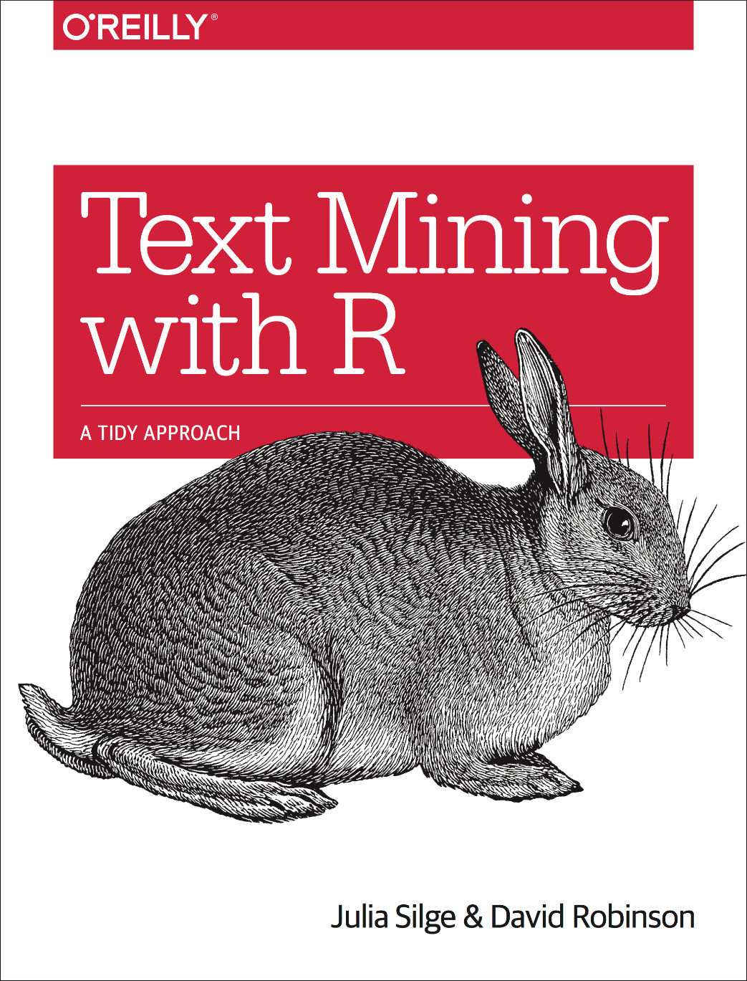
Additional Readings
Text Mining with R
Full PDF available online here
To request your own twitter account archive to analyse, click here
Notes:
Link to the PDF online: https://www.tidytextmining.com/
Link to twitter account archive request: https://help.twitter.com/en/managing-your-account/how-to-download-your-twitter-archive

Slide 6
Questions?

